Slide 2
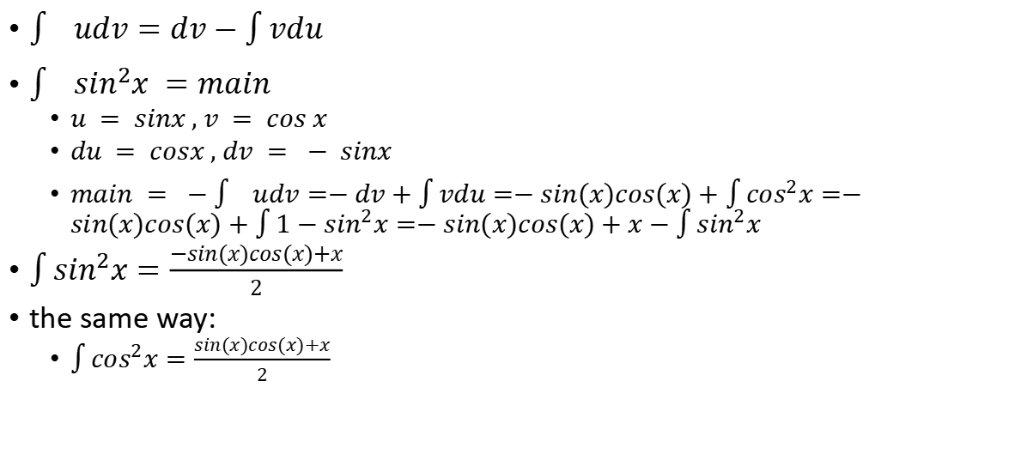
partial integration
$\int{udv=dv−\int{vdu}}$
$\int{\sin^{2}x =main}$
$u = sinx , v = cos x$
$du = cosx , dv = − sinx$
$main = −\int{udv=−dv+\int{vdu=−sin(x)cos(x)+\int{\cos^{2}x}}}=−sin(x)cos(x)+\int{{1−sin}^{2}x}=−sin(x)cos(x)+x−\int{\sin^{2}x}$
$\int{\sin^{2}x}=\frac{−sin(x)cos(x)+x}{2}$
the same way:
$\int{\cos^{2}x}=\frac{sin(x)cos(x)+x}{2}$

Slide 3
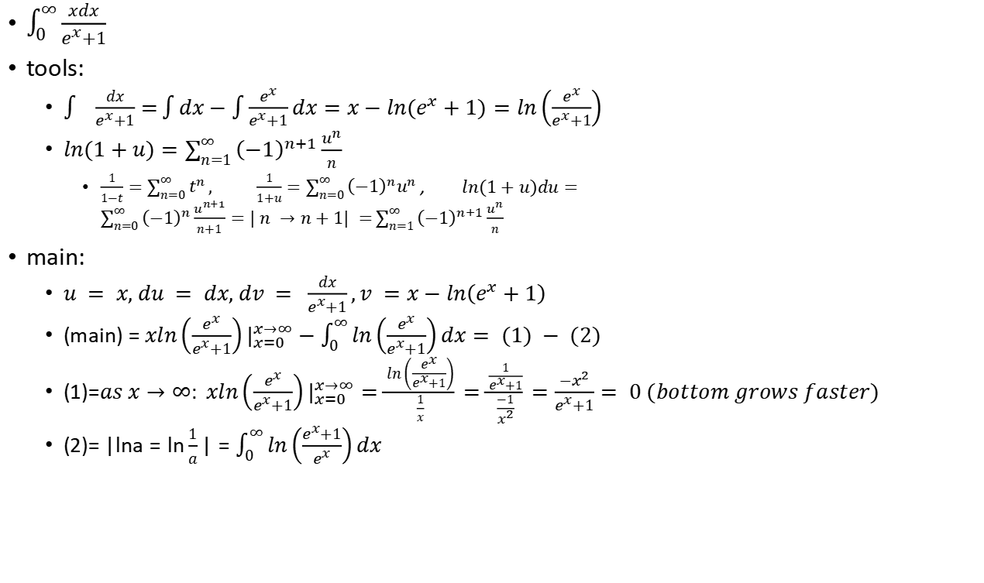
A viewer suggested integral.-1
$\int_{0}^{∞}{\frac{xdx}{e^{x}+1}}$
tools:
$\int{\frac{dx}{e^{x}+1}=}\int{dx}−\int{\frac{e^{x}}{e^{x}+1}dx}=x−ln(e^{x}+1)=ln\left(\frac{e^{x}}{e^{x}+1}\right)$
$ln(1+u)=\sum_{n=1}^{∞}{{\left(−1\right)}^{n+1}\frac{u^{n}}{n}}$
$\frac{1}{1−t}=\sum_{n=0}^{∞}{t^{n}}, \frac{1}{1+u}=\sum_{n=0}^{∞}{{{\left(−1\right)}^{n}u}^{n}}$ , $ln(1+u)du=\sum_{n=0}^{∞}{{\left(−1\right)}^{n}\frac{u^{n+1}}{n+1}=| n →n+1| =}\sum_{n=1}^{∞}{{\left(−1\right)}^{n+1}\frac{u^{n}}{n}}$
main:
$u = x, du = dx, dv = \frac{dx}{e^{x}+1},v =x−ln\left(e^{x}+1\right)$
(main) = $xln\left(\frac{e^{x}}{e^{x}+1}\right)|_{x=0}^{x→∞}−\int_{0}^{∞}{ln\left(\frac{e^{x}}{e^{x}+1}\right)dx}= (1) − (2)$
(1)=$as x→∞: xln\left(\frac{e^{x}}{e^{x}+1}\right)|_{x=0}^{x→∞}=\frac{ln\left(\frac{e^{x}}{e^{x}+1}\right)}{\frac{1}{x}}=\frac{\frac{1}{e^{x}+1}}{\frac{−1}{x^{2}}}=\frac{−x^{2}}{e^{x}+1}= 0 (bottom grows faster)$
(2)= $|lna=ln\frac{1}{a}|=\int_{0}^{∞}{ln\left(\frac{e^{x}+1}{e^{x}}\right)dx}$

